Slide 1
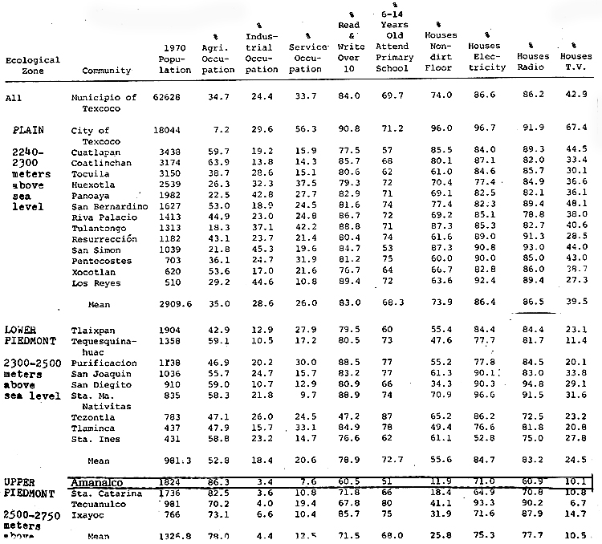
1970 Data Compilation from the National Census, Municipio of Texcoco
Notice some development indicators for Amanalco, below
Highest agricultural occupation
86%
Lowest literacy
60%
Most dirt floors
88%

