Slide 1
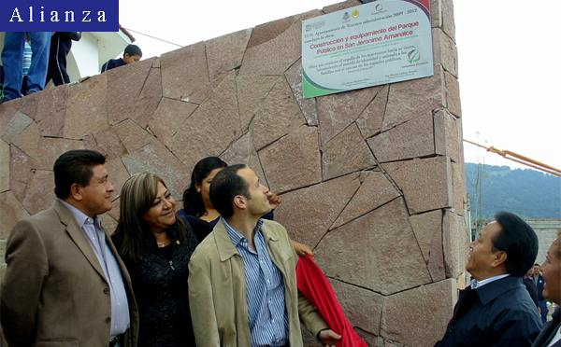
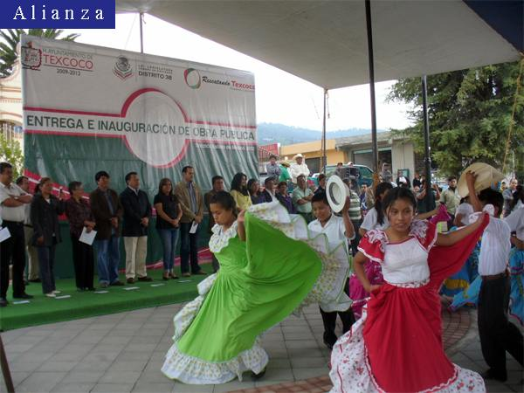
September 26, 2012. Scene at the formal inauguration of the new plaza in Amanalco
View of the new plaza
Politicians from Texcoco looking at the commemorative plaque on the new plaza
© Alianza
Amanalco’s children perform a festive dance during the inauguration of the plaza.

Slide 2
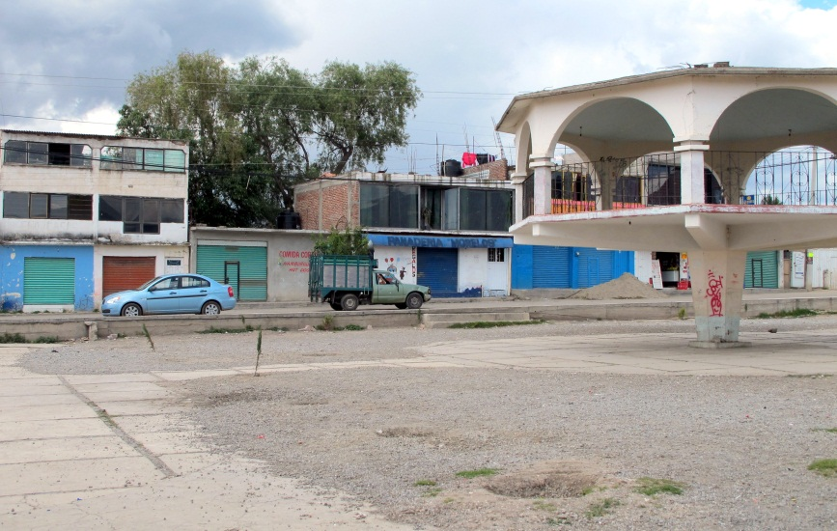
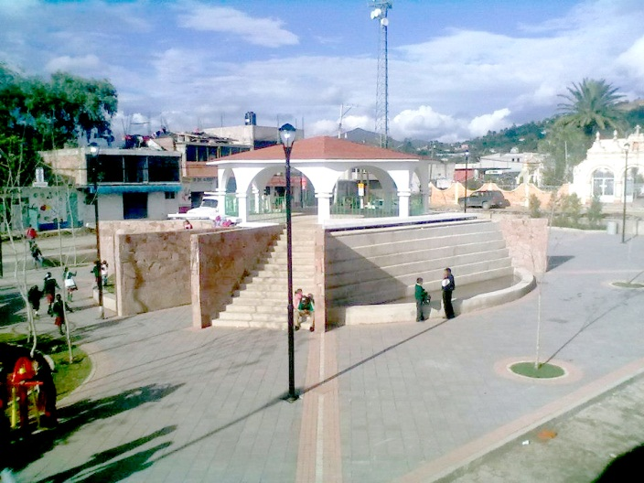
Change in the central plaza, Amanalco, 2010 and 2012
View of plaza, June 18, 2010
View of new plaza, March 10, 2013
© Manuel Moreno.

Slide 3
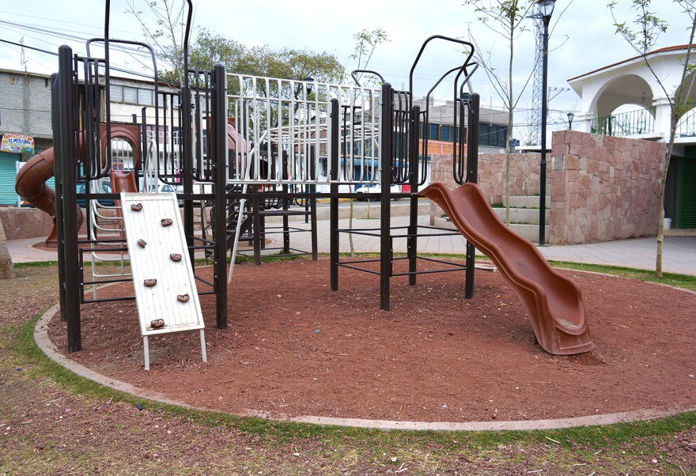
Play area for children
© Manuel Moreno.

Slide 4
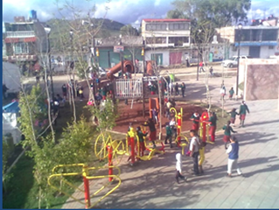
Exercise equipment for seniors
© Manuel Moreno.

Slide 5
2013, skate boarders hanging out at the new plaza
© Manuel Moreno.

