Slide 1
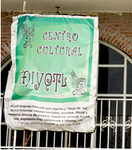
Centro Cultural Miyotl, San Jeronimo Amanalco, 2013
            © Manuel Moreno.
Banner for the Centro Cultural Miyotl hanging from Amanalco’s delegación building , April 10, 2013.
The sign says “In the Nahuatl language the word Miyotl means rays of light and seeks to create social, moral, ethical, and human expression from music, literature, painting, dance, movies, oral expression and concerts and weaving.

Slide 2
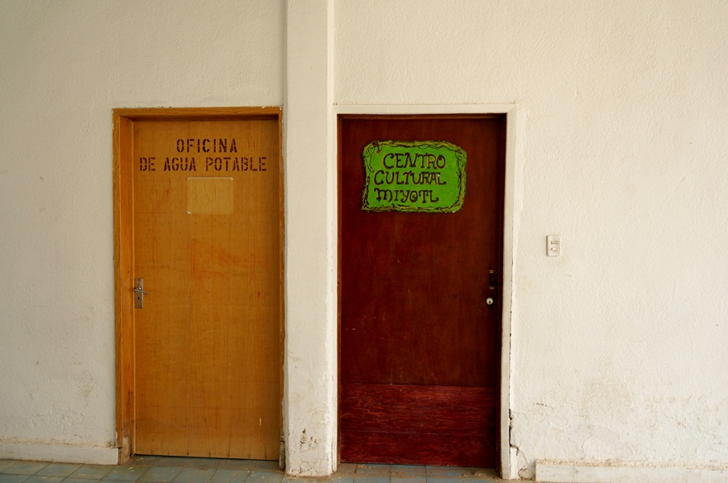
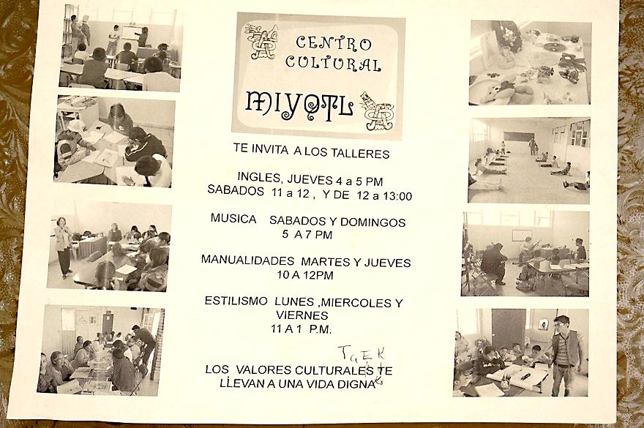
Door to the Centro Cultural Miyotl in the delegación building
© Miguel Osario.
Sign announcing various classes: English, music, crafts, cultural traditions

Slide 3
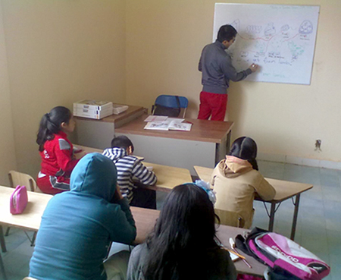
English Class
© Miguel Osario

Slide 4
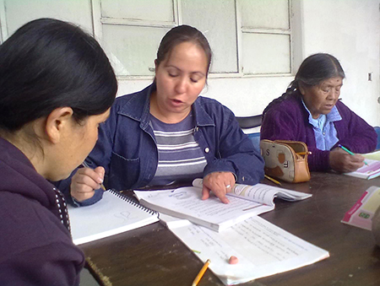
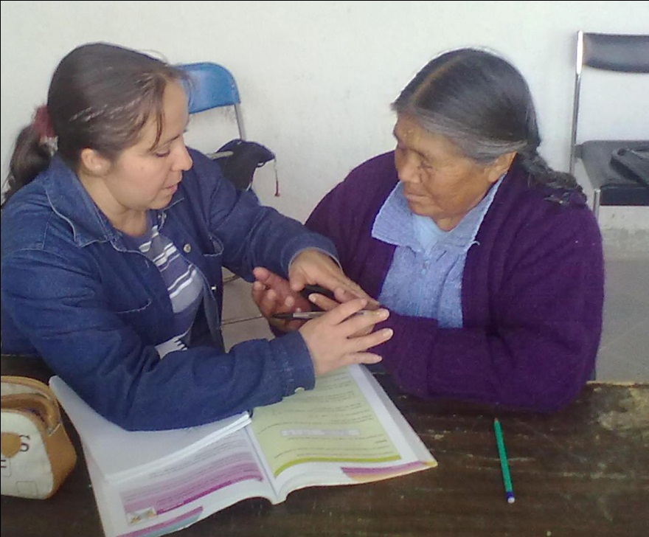
Class on literacy with seniors
© Miguel Osario

Slide 5
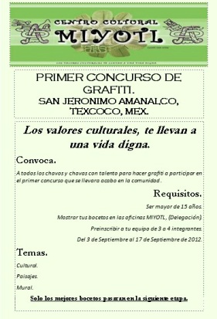
Poster for “First Contest of Grafitti”
© Miguel Osario

Slide 6
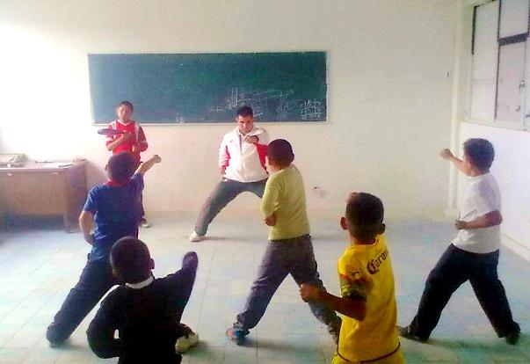
Taekwando Class
© Miguel Osario

Slide 7
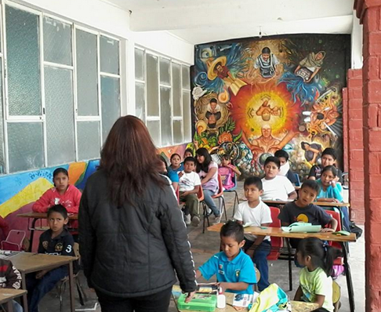
2014, a new summer school program sponsored by the Miyotl Center
© Miguel Osario

