Slide 1
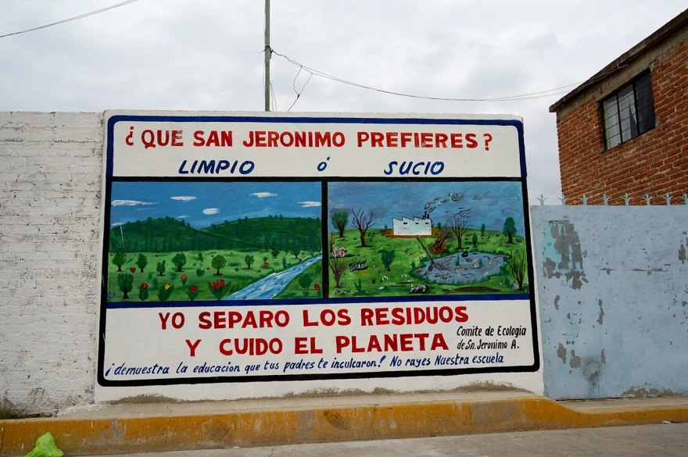
© Manuel Moreno.
[Top] What does San Jeronimo Amanalco Prefer?
Clean or Dirty
[Bottom] I separate the waste and take care of the planet (Ecology Committee of San Jeronimo A.)
Demonstrate the education given to you by your parents! Do not deface the school.

