Slide 1
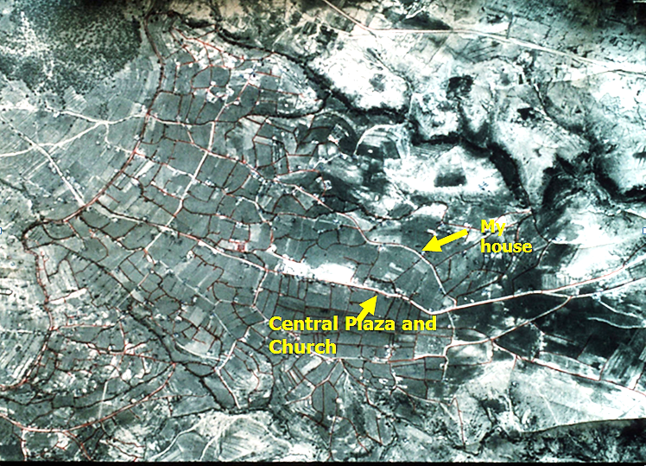
1970 Aerial Map showing central plaza, the house I lived, in and the irrigation canal shown in red
Irrigation system flowing into fields

Slide 2
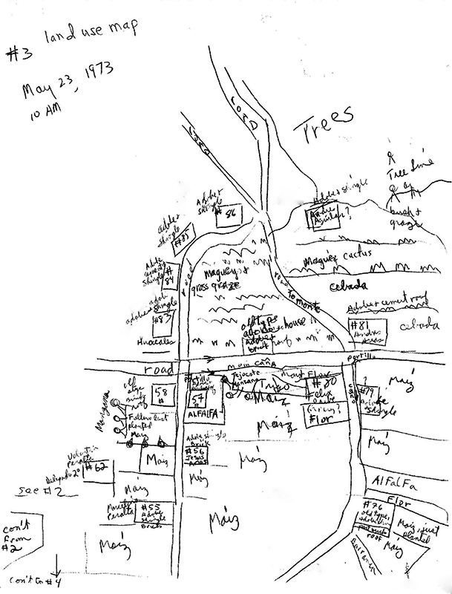
Hand drawn land use map, May 23, 1973

Slide 3
Archive materials: 1927 Schematic map of The major irrigation system which starts in the lands of Amanalco

