Slide 1
2010 trip to Tepoztlán
Tepoztlán is a town in the Mexican state of Morelos, about a 90- minute bus ride going south from Mexico City. The town has a population of 14,130 inhabitants according to the 2010 national census and it is a popular tourist day trip from the national capital. Tepotzotlán is famous for the remains of a Aztec-era temple built on top of the nearby Tepozteco mountain.
The town was the site for an early anthropological study, by Robert Redfield, of a peasant society in Mexico having a Nahua cultural heritage: Tepoztlan, a Mexican village (1930). A later study by Oscar Lewis, Life in a Mexican Village: Tepoztlán Restudied (1960), contested the picture of a tranquil, traditional society depicted in Redfield’s work.
Notes:
Oscar Lewis.

Slide 2
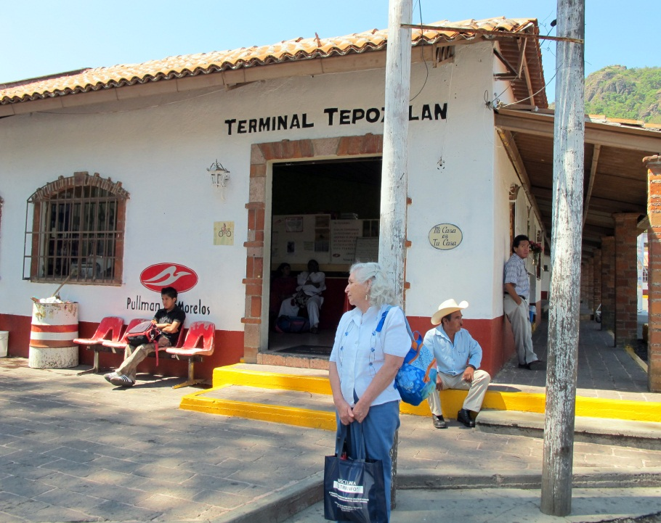
Tourism is controlled with large buses leaving people at a small terminal just outside of town. Vans come every 5 minutes to shuttle people into the plaza of Tepotztlán.

Slide 3
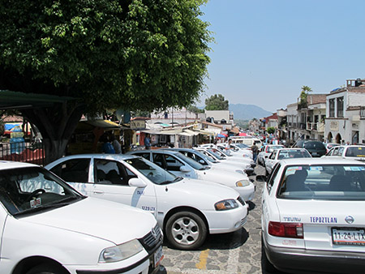
The main road is lined with shops and houses leading into the central plaza with a daily market and a large colonial church.
Even on a weekday there are crowds of people and dozens of taxi cabs at the plaza.

Slide 4
Fancy shops selling jewelry and clothing and small spas and boutique hotels can be found in Tepoztlán.

Slide 5
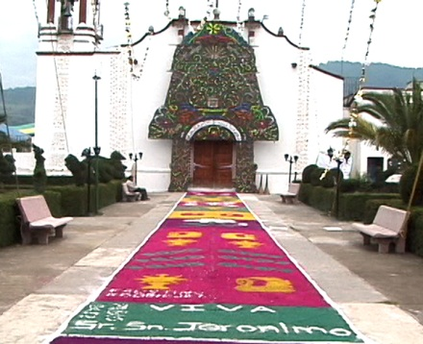
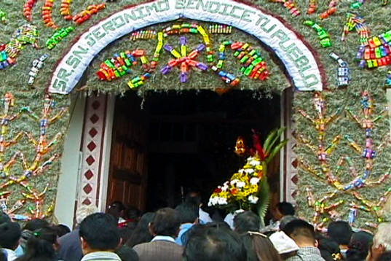
Artistic link to a pre-Hispanic heritage
This mural on the entrance to their Catholic church proclaims a proud pre-conquest heritage.
These works of art are created each year entirely out of different-colored local seeds.
A variant of this kind of folk art, constructed of local flowers and plastic toys, is seen in Chapter 8 within the video of the Patron Saint’s Fiesta in Amanalco.
See a short video, “Tepoztlan - "The Language of the Seeds" about Tepotztlán’s folk art at: http://www.youtube.com/watch?v=svfAX9CzQm4

Slide 6
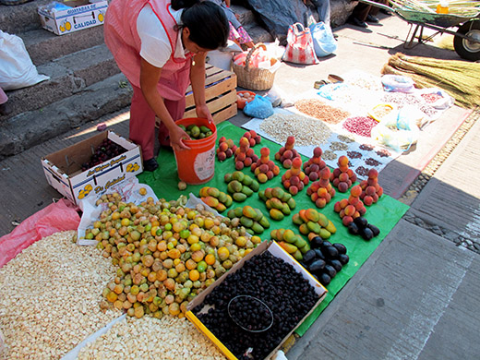
Across from the church is a large daily market with local produce and manufactured items

Slide 7
This includes a wide variety of herbal medicines
The red signs, from left to right, claim that these herbs cure liver and digestive problems, circulation issues and diabetes.

Slide 8
A major attraction is the Aztec-era temple to Tepoztecatl, the god of pulque (an alcoholic beverage made from the sap of the agave cactus) on a mountain ridge overlooking Tepotzotlán.

Slide 9
The local myth of Tepoztecatl tells of a protector man-god who was both a pre-Hispanic leader and a diety. As in Amanalco, with its mythology about the man-god Nezahualcóyotl (see chapter 9), both of these beings are key sources of unity and resistance to outside incursions into their environment.
For more information on the myth of Tepoztecatl see: www.docfilm.com/webpages/Mexico/DefOfPpl.html

