Slide 1
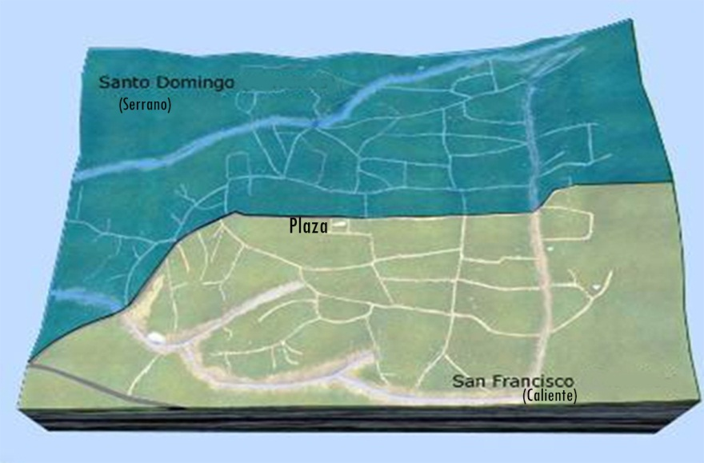
Amanalco’s two administrative sides of the community:
Santo Domingo (Serrano) and San Franciso (Caliente).
Adapted from Guillermo Torres. 2008. “Los jóvenes de San Jerónimo Amanalco” Master’s Thesis, Mexico City: Universidad Iberoamericana, P65.

