Slide 1
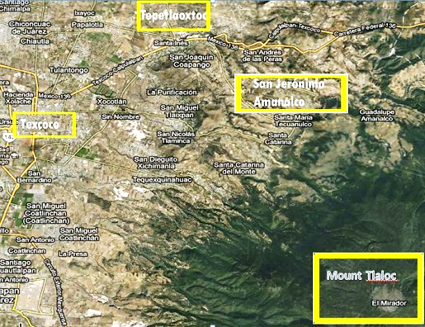
San Jerónimo Amanalco, and some places mentioned in Chapter 1

