Slide 1
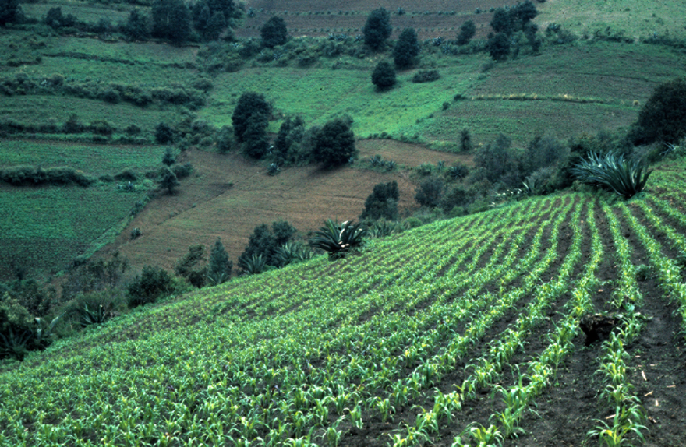
Resources from Amanalco’s Forest Domain
High mountain corn field 9000 feet, 1973

Slide 2
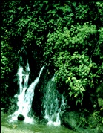
Large mountain springs, 2003

Slide 3
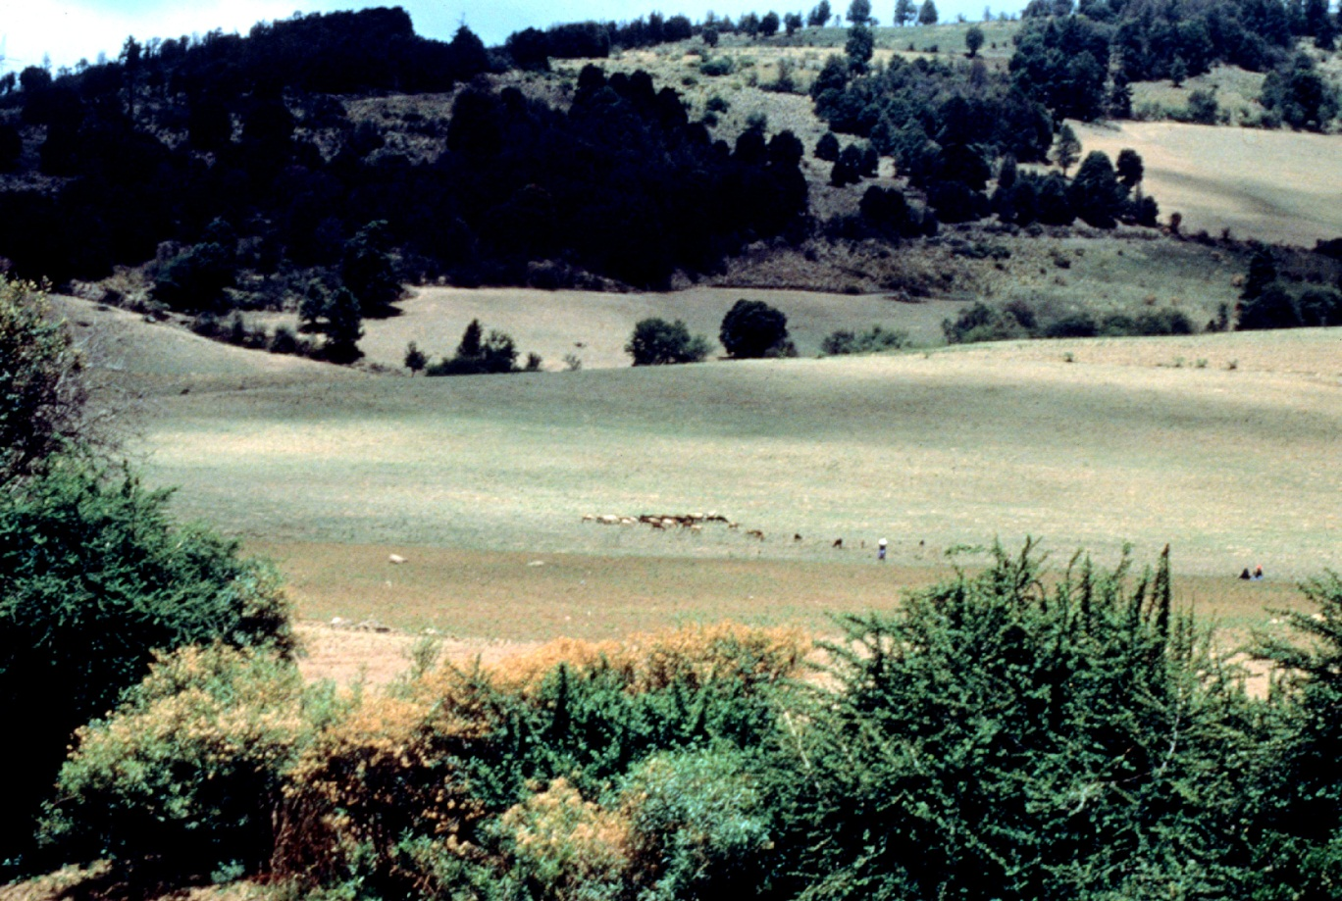
Grazing area in mountain zone, 1978

Slide 4
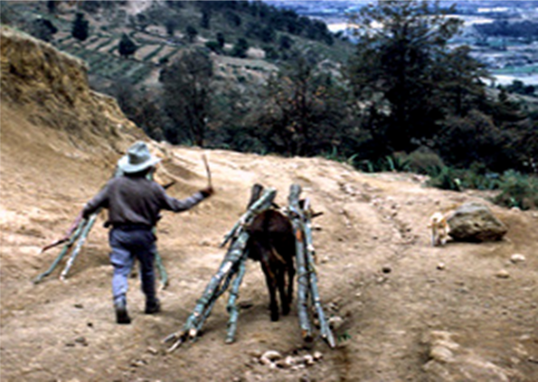
Bringing wood back home from the forest

Slide 5
Selling household brushes made from mountain grasses, in the Texcoco market

