Slide 1
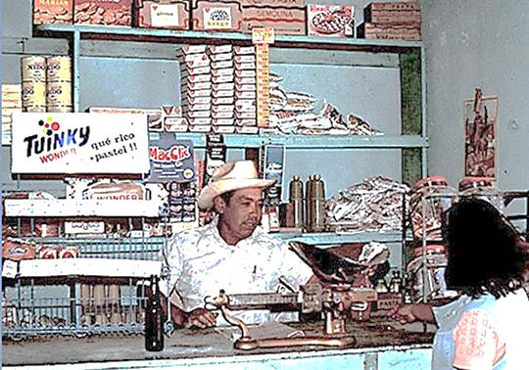
Glimpses into the future from 1978 Introduction of four global products
Clik pens
Nestle Baby Formula
Twinkys & Wonder Bread
Alka Seltzer
The village’s main store in 1978

