Slide 1
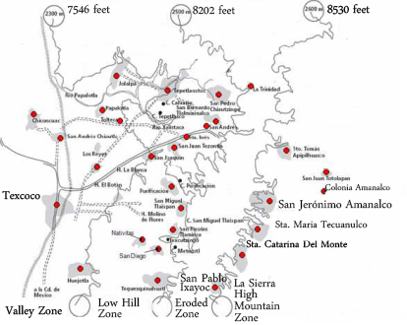
Figure 3.2 Ecological Zones in the Texcoco Region and the Indigenous communities in the Sierra Zone

